Slide 1
Customer Churn Project
Paul Aleksis & Soledad Musella

Slide 2
The customer churn rate is the annual percentage rate at which customers stop subscribing to a service .
In churn management is important to identify which are the main factors that trigger the decision.
We developed 3 business questions that can guide us to understand how to interpret the churn rate.

Slide 3
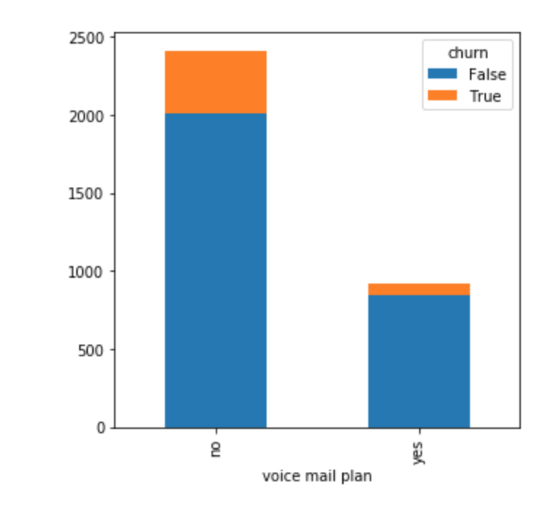
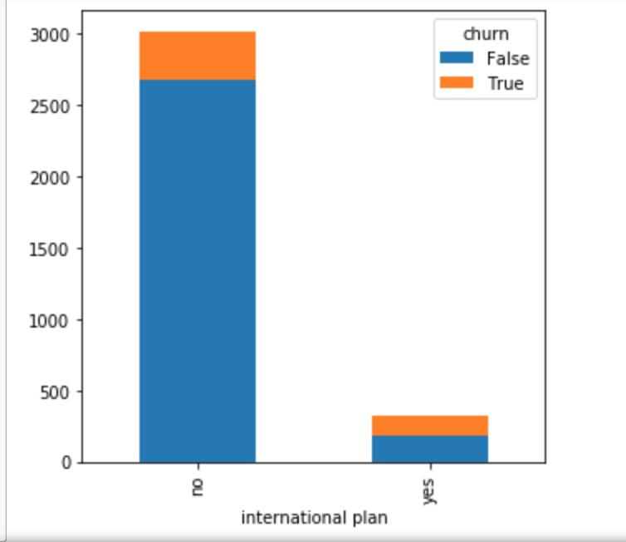
Does having both a voicemail plan and an international plan result in less churns?

Slide 4
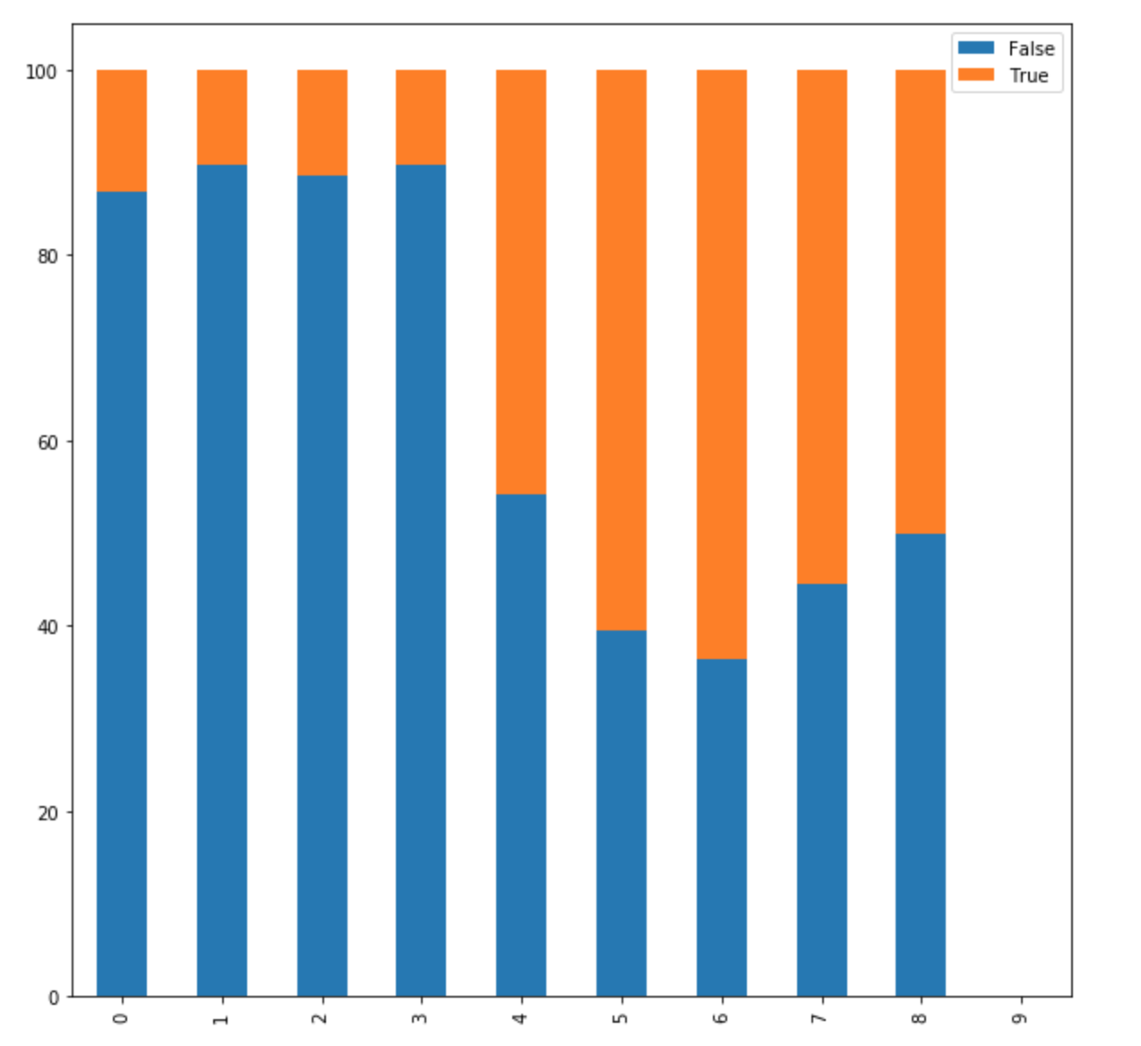
Does the quality of the customer service can affect the churn rate?

Slide 5
We used the following algorithms :
Logistic Regression
Decision Trees
K-Nearest Neighbours
Random Forest
THE MODEL WE CHOOSE AS THE BEST MODEL IS DECISION TREES.
The reason stands in the results of the model:
Train: 0.92
Test: 0.88

Slide 6
Model Interpretation
1. The most important feature in churn rate is customer service calls with an impact of 26% :
1.1 If our customer had on average more than 3.5 customer service calls it would increase our chance to churn by 80%
1.2 If our customers had less than 3.5 customer service calls it would result in a 24% churn rate
2. The second important feature is the international plan with an impact of 24%.

Slide 7
Prediction of costs for the company Those are the industry standard numbers for North America:
False positive cost (FPc) - $11.74
True negative cost (TN) - $0
False negative cost (FN) - $587
True positive cost (TP) - $11.74

Slide 8
Cost of implementation of the Model
Based on our 667 customer test we have found that these numbers align accurately with the costs to adopt our model.
The cost to implement our model is: $9,075.02
The cost of not implementing our model is: $52,830
We are happy with these costs and understand that our model is prone to making type 1 error but the cost of a type 1 error is only $11.47. The cost of a type 2 error is $521 per customer.

Slide 9
Stakeholder interpretation
Alpha - There is a 27% chance that our model will say that a customer will churn when they actually wont.
Power - There is a 7% chance that our model will say that a customer will not churn when they actually will.
Precision - Of the recalled churners, our model will get 49% of them right
Accuracy - Of the 76% recalled it will accurately state there is a potential churn 85% of the time.
Recall Score - The model will recall 76% of potential churners

Slide 10
Actionable plan for stakeholders:
Focus on customer service. This is a big driving decision for consumer churn rates.
The happier our costumers feel during this time the more likely they are to stay loyal.
We can implement customer surveys at the end of some customer service calls to grade our employee’s customer satisfaction.

